Slide 1
Group 10:
The Correlation between changes in The Stock Market & Changes in the Housing Price Index
Vicky Chernokhlebova
Ben Gerson
Mohammed Habib
Ming Lei

Slide 2
Null Hypothesis and Questions
Null hypothesis: “There is no relationship between stock market index changes and housing price index changes”
Alternative hypothesis: “There is a relationship, the HPI changes as a function of the stock market index”
------------------------------------------------------------------------
Is there a relevant correlation between changes in the Stock Market and changes in the Housing Price Index?
What did effects did changes in the stock market have on the Housing Market?

Slide 3
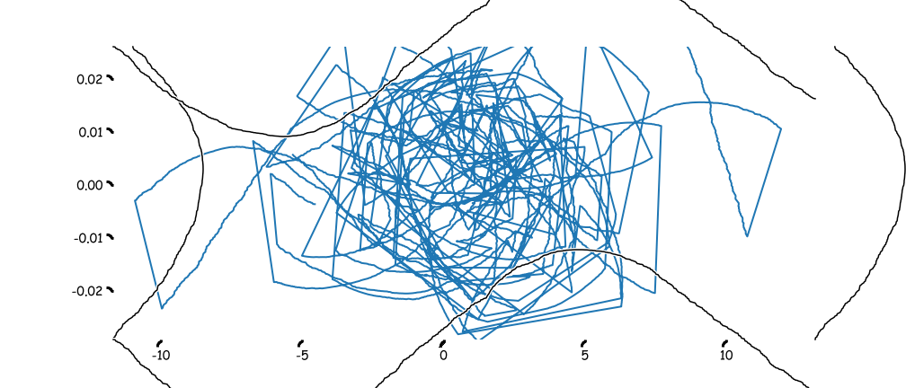
Results of our findings, summarized.
Not good enough. Lacks detail.
That’s why we then did a...

Slide 4
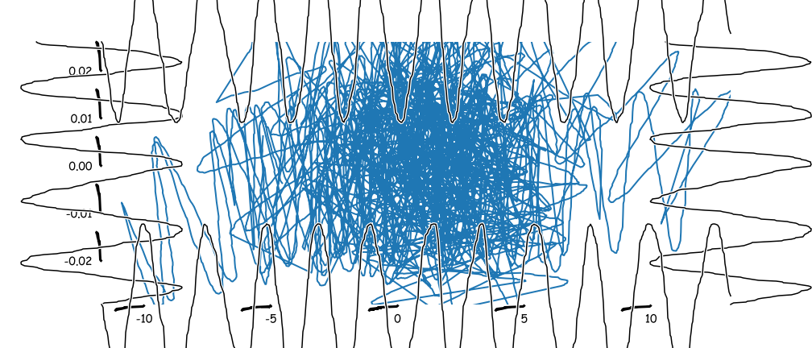
Detailed graph of market index flux data
versus quantum housing yield ratio
using deep Romanov polarity analysis

Slide 5
Getting the Data
Data Retrieval:
We used two data sets:
Housing Price Index from the Federal Housing Finance Agency
Stock Market Data from the Federal Reserve Economic Data ®
Data Cleaning Challenges:
Stock data gave a daily average. Had to be “averaged” for each month because HPI data is a change per month only (no daily data).
Stock data had to be converted from stock “units” to a percent change
HPI was divided into geographic regions (9 census regions) as well as LOTS of cities, zip codes, etc.
Very rich data set but very large
Decided to take U.S. average as well as 8 census regions

Slide 6
Data limitations
Data set limitations:
Different Units: Stock market indexes use a composite average of actual stocks.
Housing Price Index is a percent change over an “anchor value” (January 1991)
Overlap: The only continuous data set was from January 2009 to January 2019.
Loss of resolution: Stock index data had to be averaged per month to match units for HPI

Slide 7
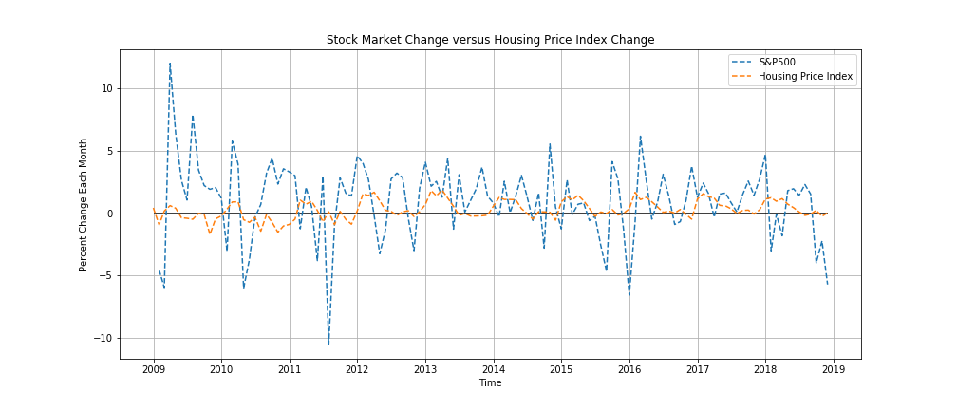
Cleaned Data Output
Fluctuations in Stock Market Index (S&P 500) and HPI

Slide 8
Cleaned Data Output
Fluctuations in Stock Market Index (S&P 500) and HPI
HPI fluctuations generally within the range of +/- 1%
S&P 500 fluctuations much larger some up to +/- 10%
Positive and negative changes do not track between indexes.
In a time series there appears to be little relationship between a rise/fall in the stock index and a corresponding rise/fall in HPI

Slide 9
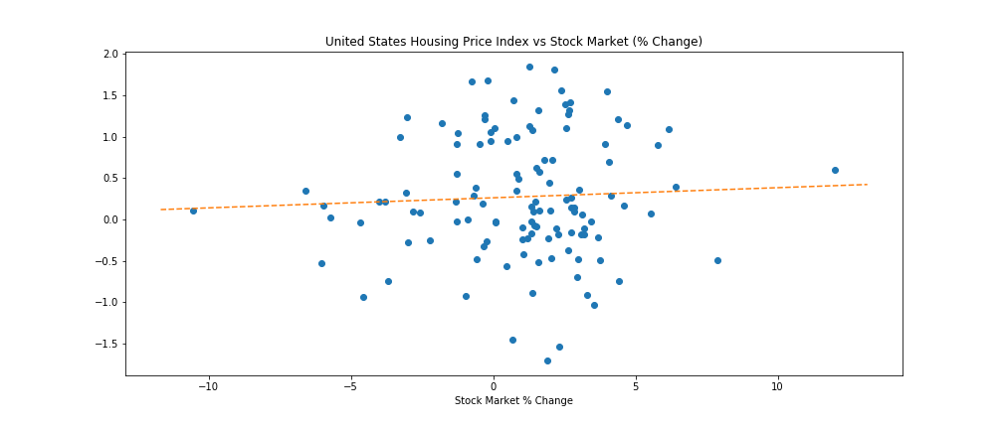
Scatter Plot showing the linear regression of
Stock Market Change(%) vs HPI Change(%)
for the United States Overall

Slide 10
What does this mean?
The linear regression line shows HPI change as a function of the stock market change.
This is not over time, it only means that as a general rule as the stock market goes up, so will housing prices.
Why?
Economic growth across sectors (if stocks are doing well, it’s a general indicator buyers have more money to spend)?
Population grown drives both (more economic output and more demand for housing)?
Independent factors such as federal reserve interest rate and prime rate?
This is true for the U.S. on average as well as most housing census regions

Slide 11
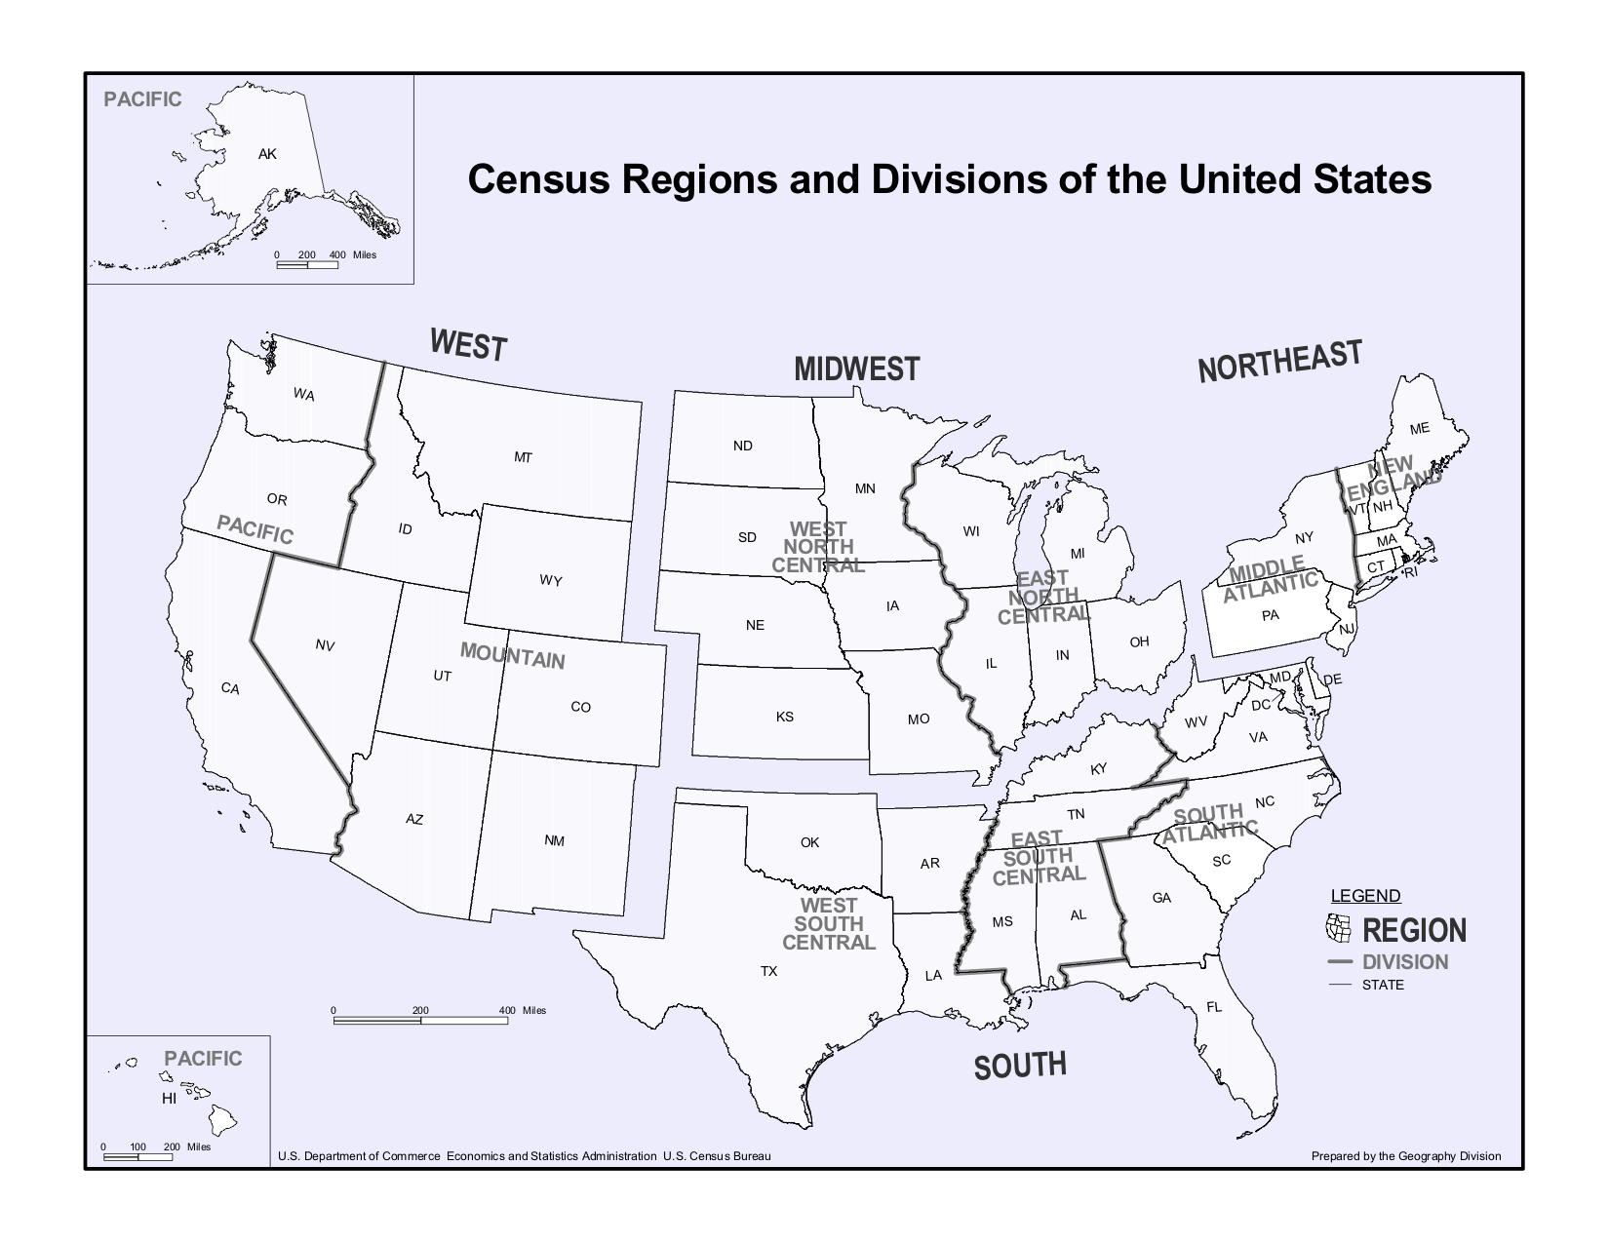

Slide 12
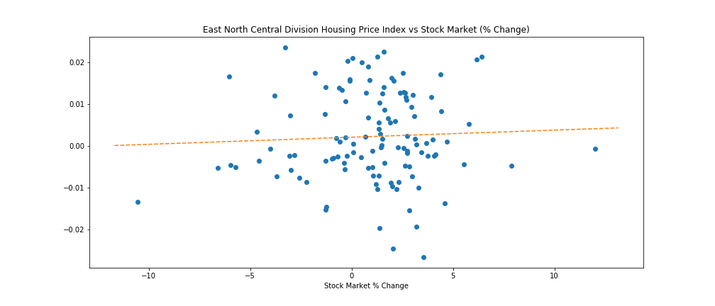
North East Central Division

Slide 13
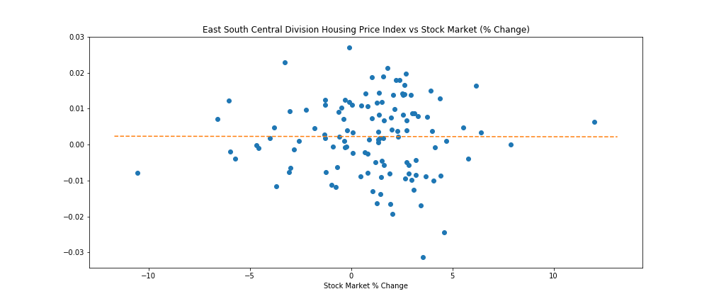
South East Central Division

Slide 14
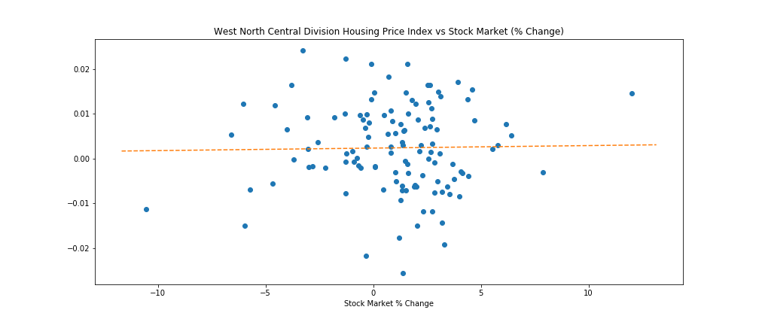
North West Central Division

Slide 15
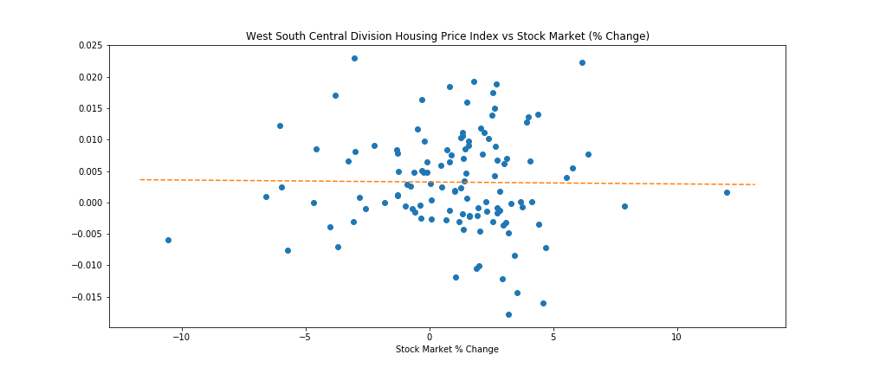
South West Central Division

Slide 16
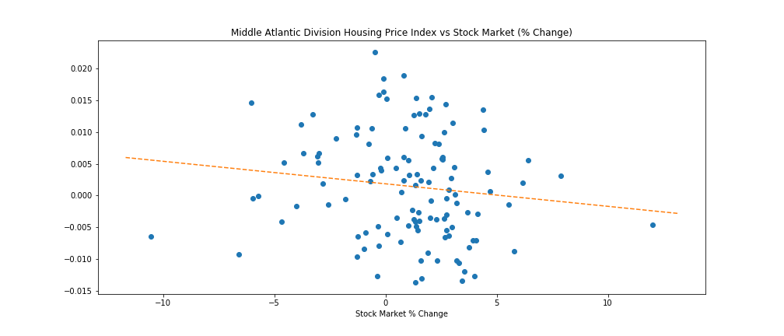
All very similar with tiny slopes except:
Middle Atlantic Division

Slide 17
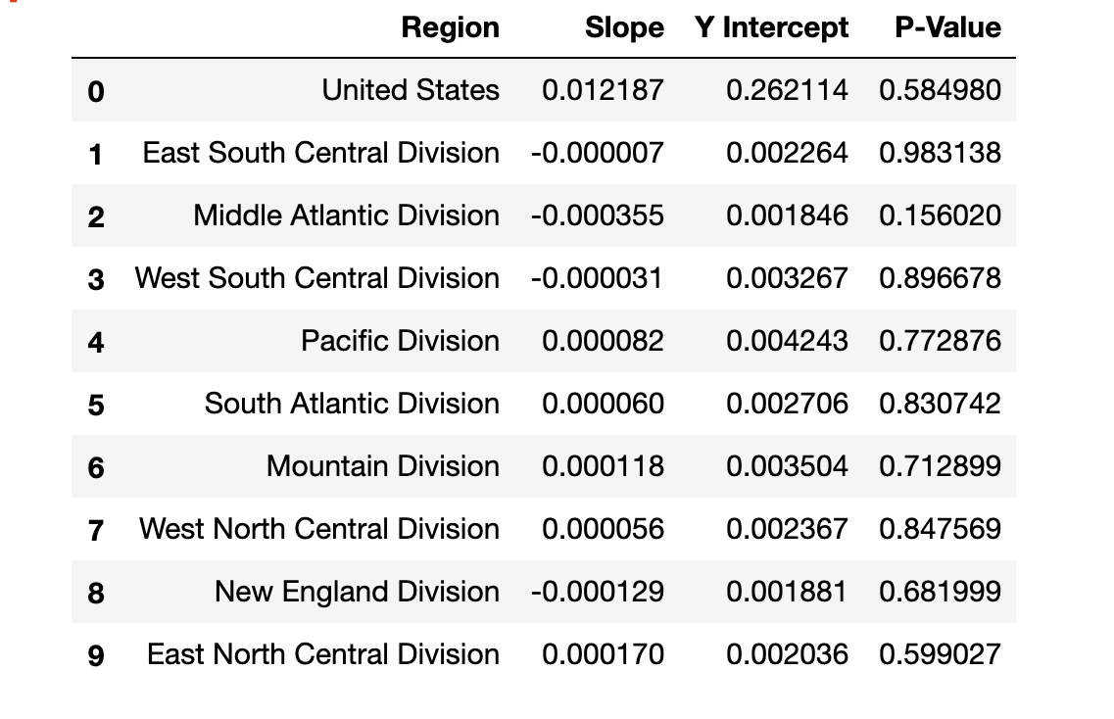

Slide 18
What’s up with the Middle Atlantic Division?
MAD is NY, NJ and PA. Would expect the HPI to increase above the national average due to high housing costs in the region.
Instead, when graphed as a function of the stock index, it decreases.
As stocks do better, housing price index drops. (Inverse relationship)
Why?
High percentage of renters instead of home buyers?
Offset by low housing costs in more rural areas (i.e. PA)?
Assets are mostly in stocks as opposed to housing?
Analysis limitation?

Slide 19
Discussion/Conclusion
Did we get all of our questions answered relative to the data we collected?
There were some limitations on the data set we used but by conducting a regression analysis it showed a general trend but did not predict the outcome for minor market fluctuations
What do our findings mean?
There is a weak positive correlation between stock market average increase over a 10 year period and Housing Price increase.
If you buy a house now, you can roughly predict what it will be worth in the future, by projecting stock index growth.
BUT: There are exceptions: certain regions HPI actually decreases even with a growth in stock market over 10 year period.
* Because of the low P value, we cannot say one stock market changes cause HPI change*

Slide 20
Post Mortem
This analysis tool gave certain insights, but also raised a lot of questions.
Are there any types of analysis other than regression which would have showed other trends in the data?
Do minor short term fluctuations in the stock market impact the HPI?
We found an unexpected trend that warrants future investigation:
Higher resolution breakdown by city/county/zip
Incorporation of external factors such as federal reserve rate
Different mathematical model to assess short-term fluctuations

